Slide 1

Resident Assistant Training

Slide 2

What is Title IX?
“No person in the United States, shall, on the basis of sex, be excluded from participation in, be denied the benefits of, or be subjected to discrimination under any educational program or activity receiving federal financial assistance.”
- Title IX of the Education Amendments of 1972

Slide 3
What Title IX is NOT
Not only for athletics
Not only for women
Not only about sexual assault

Slide 4
What is Title IX?
Environment free from harassment
Speech, behavior, images
Schools Must:
Stop -- the behavior
Prevent -- the behavior from recurring
Remedy – the effects of behavior

Slide 5

Did you know?
More than 50 percent of college sexual assaults occur in August, September, October, or November, and students are at an increased risk during the first few months of their first and second semesters in college.

Slide 6
I'm a Student Leader. What does that mean for me in regards to Title IX?

Slide 7
Responsible Employee
Responsible Employees are required:
Report any behavior of which you are aware, or reasonably aware, as soon as possible
Report as much information as you know
Names, behavior, location, etc.
All PSU employees EXCEPT those who are designated as confidential resources.

Slide 8
What a Responsible Employee Must Say . . .
Inform reporting party of:
The Responsible Party’s obligation to report the information to the Title IX Coordinator
Where they can report confidentially
Counseling and other support services
The right to report the crime to campus or local law enforcement
Notes:
Your RD is a need to know employee, must keep them in the loop, but otherwise you are responsible to keep the privacy of the person who discloses to you. Others who “need to know” will be determined in conjunction with student life and the Title IX Office.

Slide 9
Campus Security Authority (CSA)
What does being a Campus Security Authority mean?
To report to Campus Safety allegations of Clery Act crimes
Who is a CSA?
Campus Safety
Individuals specified to receive reports of Clery allegations
Any official having significant responsibility for student and campus activities
How does a CSA fulfill their obligations?
Report all Clery allegations to Campus Safety

Slide 10
What Do I Report?

Slide 11

Clery Act Categories of Crimes
Criminal Offenses
Criminal homicide, murder, manslaughter, non-negligent manslaughter, sexual assault, rape, fondling, incest, statutory rape, robbery, aggravated assault, burglary, motor vehicle theft, arson
Hate Crimes
Race, religion, sexual orientation, gender, gender identity, ethnicity, national origin, disability
VAWA Offenses
Dating violence, domestic violence, stalking
Arrests & Referrals for Disciplinary Action
Weapons, drug abuse, liquor law violations

Slide 12
Prohibited Conduct
Sexual Harassment
Sex/Gender Discrimination (disparate treatment because of sex)
Non-Consensual Sexual Intercourse
Non-Consensual Sexual Contact
Sexual Exploitation
Stalking
Physical Harm and Intimidation
Harassment, Bullying or Cyber bullying
Intimate Partner Violence
Retaliation

Slide 13
Scope of Policy
Title IX policy applies to all University employees and students, when engaged in University sponsored events on or off University property.
Prohibited Conduct Occurring:
On Campus
Within the context of any PSU education program or activity
Has continuing adverse effects on campus, on members of the PSU community
Regardless of where the conduct occurred when it occurs, i.e., on or off campus

Slide 14
Scope of Policy
Regardless of when, where or with whom the conduct occurred, the University will offer resources and assistance to any individuals who have been affected by Prohibited Conduct.

Slide 15

Not Within the Scope
Events occurring prior to arriving on campus
e.g., An assault that occurred during high school

Slide 16
Minors on Campus
Prospective students are likely minors
Report any concerns to
Campus Safety:
501.370.5370, Ext. 5370
501.804.4246

Slide 17
How Do I Report?

Slide 18
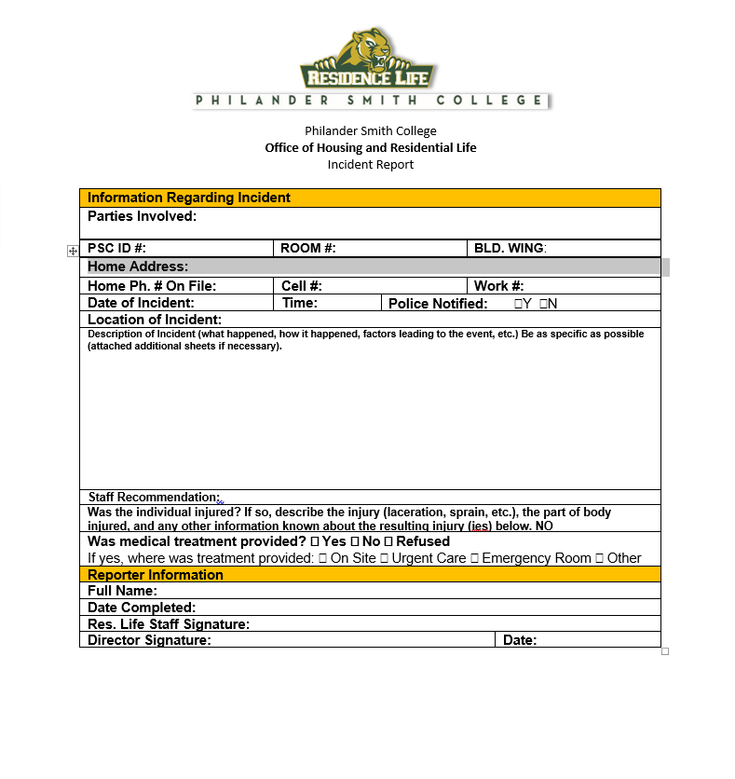
Incident Reports

Slide 19
PSU Title IX Coordinator
Rhonda Lovelace Tilmon, Ed.D.
Chief Student Affairs Officer Office of Student Affairs Philander Smith College 900 W. Daisy L. Gatson Bates Drive
Little Rock, AR 72202 (501) 370-5297| rlovelace@philander.edu
Availability of Counseling and Advocacy

Slide 20
Writing a TIX Incident Report
Fill out the form to the best of your ability. As a responsible employee you cannot report anonymously.
Be clear. Use first/last names. Avoid pronouns.
If you don’t know the exact date of the incident, indicate that in the narrative.
Notes:
Avoid pronouns- isn’t clear who you’re talking about

Slide 21
What Do I Say When Someone Discloses to Me?

Slide 22

Responding to Disclosure
Clarify role as a Responsible Employee.
Remind them that you must report to the TIX Coordinator, but talking to the TIX Coordinator is optional.
The TIX Coordinator will keep the disclosure private.
Know your amnesty policy
Do NOT investigate! Do NOT mediate!
Listen. Support. Refer. Measures. Document.

Slide 23

Confidential Resources
On Campus
At Philander Smith University, completely confidential support services can be provided by:
Clinical Director— nurse@philander.edu
Rev. Ronnie Miller-Yow, Chaplain— rmiller-yow@philander.edu
Notes:
Make sure that they know that Hank is only a confidential EE in that role

Slide 24
Availability of Counseling and Advocacy
Counseling is available for victims of sexual assault by contacting the University Psychologist at (501) 952-5275, as well as in the community at the Little Rock Safe Places Sexual Violence Center, (501) 374-7233, the Rape Crisis Center at (501) 801-2700, and the Center for Healing Hearts and Spirits at (501) 372-3800. Counseling and other mental health services for victims of sexual assault are available on campus and in the community. Students may contact the Campus Health and Wellness Center to speaking the Campus Nurse at (501) 370-5333 and/or the Counselor at (501) 952-5275. Community mental health agencies, such as Little Rock Mental Health—(501) 686-9300, ARConnect Telehealth Services 1-800-482-9921, counselors and psychotherapists in private practice in the area can provide individual and group therapy. The Arkansas Coalition Against Sexual Assault (ACASA), Committee Against Spouse Abuse (CASA) Women’s Shelter, or Domestic Violence and Rape Crisis Programs may assist with making referrals for individual counseling and support groups and in identifying non-counseling campus and community resources that may be of additional help and serve as a victim advocate upon request. The use of these or any other resources are at the discretion of the parties.

Slide 25
What Happens After A Report is Made?

Slide 26
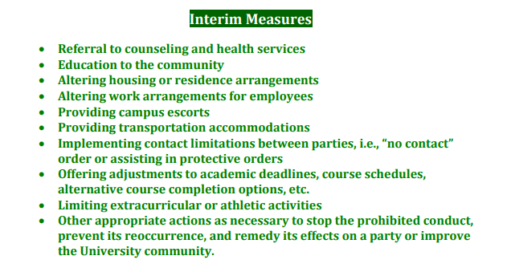
Interim Measures

Slide 27
Culture Building

Slide 28
Consent Defined
Must be informed, knowing and voluntary – freely given through clear words or action​
Cannot use force, threats, intimidating behavior, or coercion (unreasonable/persistent pressure).​
It cannot be given by someone known to be – or who should be known to be mentally or physically incapacitated.​
​
Consent requires the following conditions: ​ ​
1. All parties are fully conscious.​
2. All parties are equally free to act.​
3. All parties have positively and clearly communicated their intent.

Slide 29
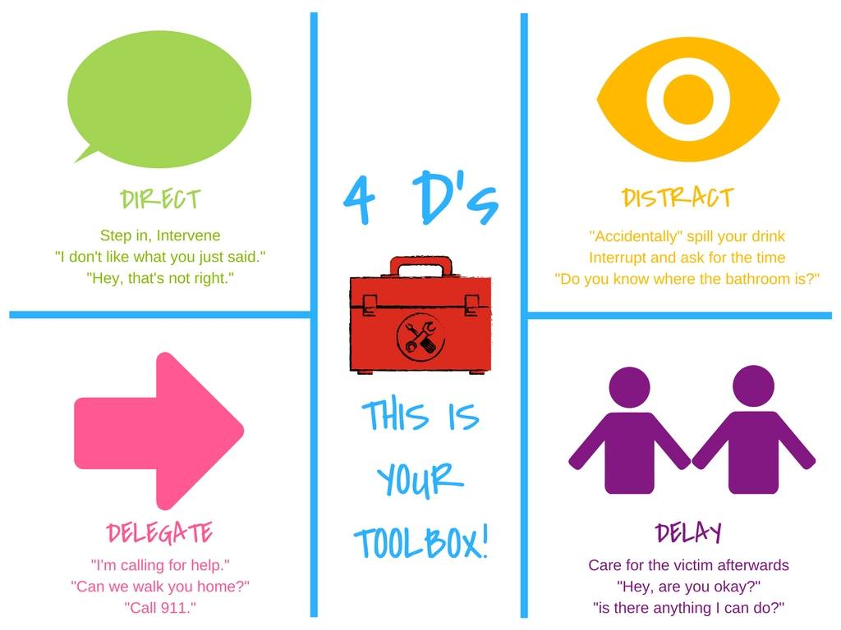
Bystander Intervention

Slide 30
Social Media
Imagine this scenario: You are seeing someone. You each decide to exchange nude selfies of each other. Life is good. Two weeks later you break up with the person. Do you trust the person whose heart you just broke to respect you enough not to share the photo on Instagram? Snapchat? Facebook? GroupMe?
You can be cyberbullied, stalked, sexually harassed via social media

Slide 31


What are some barriers that cause people to not report?
Do you have any barriers or biases?
How can we develop our
Student education and
Prevention programming?
Notes:
Shaming. Shouldn't have been wearing that. Shouldn't have been drinking.

Slide 32
Recognizing Trauma
Anxiety/Depression​
Low self-esteem​
Reinforcements of stereotypes​
Flashbacks​
Disrupted sleep, loss of concentration​
Suicidal thoughts/self-harming ​
Breakdown in trust
Dizziness​
Dilated pupils​
Dry mouth​
Muscle tension​
Hyperventilation​
Rapid Speech​
Anxiety​
Floods of Emotion​
Unfocused eyes​
Disassociation​
Low energy​
Non-responsive

Slide 33
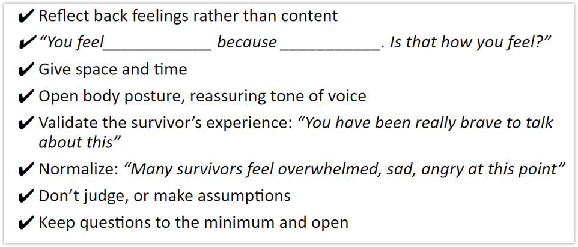
How do you help?
Be present, active listening, be patient​
Validate their feelings​
Offer resources​
Counseling/Campus pastors, Title IX office support (adjust class schedules, police report, no-contact orders, room re-assignments, etc)

Slide 34
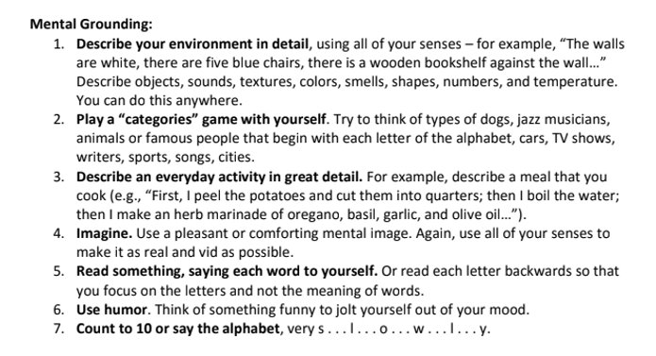
Grounding Techniques for those in Crisis

Slide 35
Building Culture
Pay attention to culture, and shut down conversations, jokes, actions, or media that you wouldn't want directed at you or a loved one.​
Step into situations that seem like they might be getting out of hand​
Continue to build trust and bonds with your group. ​
Encourage Healthy Social Media habits

Slide 36


